Slide 1
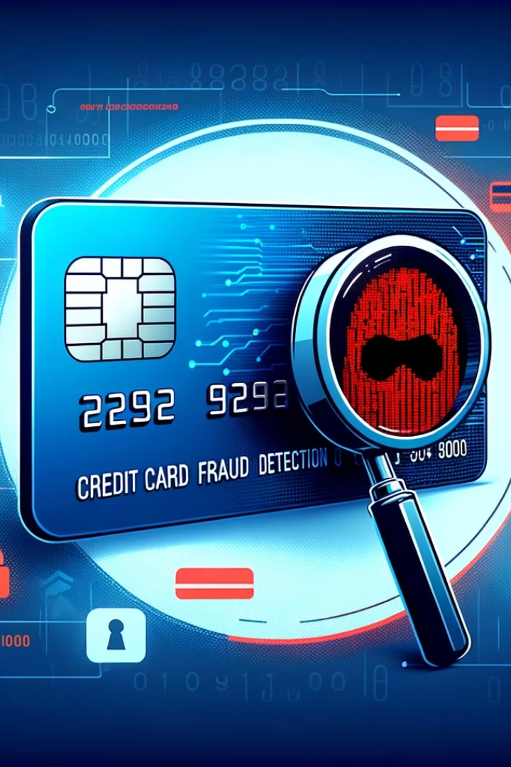
Credit Card Fraud Detection
Presentation by
Mirza Nazmul Bari Baig
Mohammad Fahad Raza
Arunoday Setu
Ashish Nahak

Slide 2


Problem Statement
Growing Concern
Need for Speed
Challenges
Credit card fraud threatens digital finance security worldwide.
Quick, accurate fraud detection prevents costly financial losses.
Traditional methods struggle with scale and evolving fraudulent tactics.

Slide 3

Project Objective
Accurate Detection
User-Friendly Interface
Real-Time Prediction
Distinguish fraudulent from legitimate transactions with high precision.
Deploy a real-time prediction system using a Streamlit web app.
Enable immediate fraud alerts for new transaction inputs.

Slide 4

Dataset Description
Data Source
Class Distribution
Dataset: creditcard.csv from Kaggle with 30 features.
Features: V1 to V28 (anonymized), Time, Amount
Class: 0 = Legitimate, 1 = Fraud
Severe imbalance: 0.17% fraud cases
Legitimate
Fraudulent

Slide 5


Data Preprocessing
Class Imbalance Handling:
Used undersampling to balance dataset.
Randomly sampled legitimate transactions to match the number of fraud cases.
Split Data:
80% training, 20% testing with stratification.

Slide 6

Model Architecture & Evaluation
Algorithm Choice
Performance Metrics
Logistic Regression for simplicity and interpretability.
Train accuracy: 91.49%
Max iterations set to 1000 for convergence.
Test accuracy: 91.37%

Slide 7
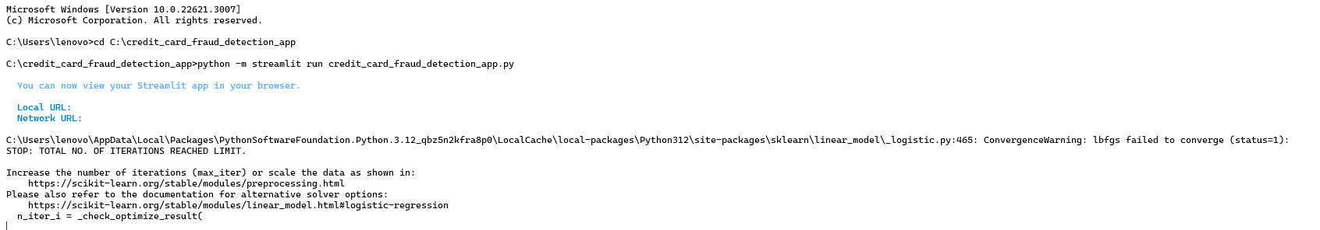
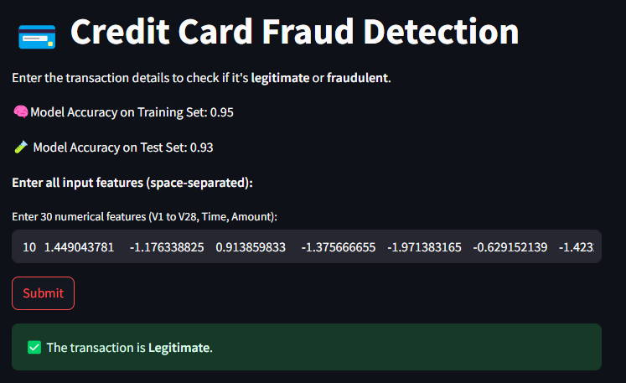
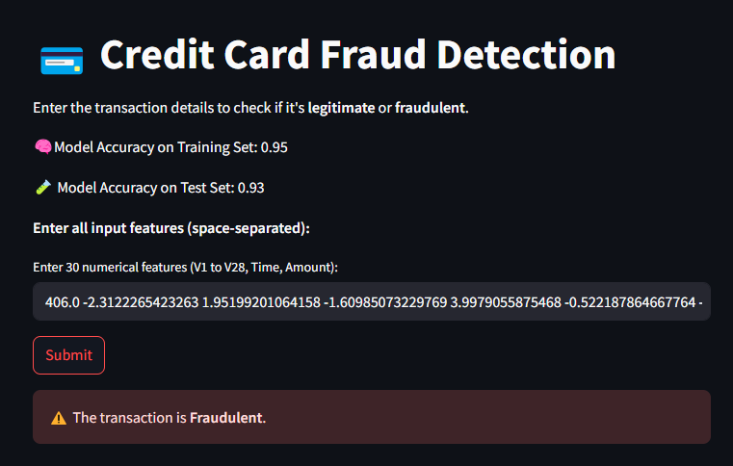
Working of Model

Slide 8


Challenges and Limitations
Imbalanced Dataset
Fraud cases less than 0.2%, affecting model training balance.
Information Loss
Undersampling discards valuable legitimate data patterns.
Feature Interpretability
Anonymized features limit understanding of model decisions.

Slide 9




Real-World Applications and Impact
Credit Card Companies
Prevent fraud and manage risk efficiently.
E-commerce Platforms
Secure online transactions from fraudulent attempts.
Banks & Financial Institutions
Protect customer accounts and assets.

Slide 10
Future Scope
1
Advanced Sampling
Replace undersampling with SMOTE for better class balance.
2
Improved Models
Integrate advanced algorithms for higher accuracy.
3
Real-Time Integration
Connect to live data pipelines for instant fraud detection.
4
Interpretability Tools
Use SHAP or LIME to explain model predictions clearly.

Slide 11

Conclusion
Successfully developed a machine learning-based system to detect credit card fraud using Logistic Regression.
Addressed the issue of class imbalance through undersampling, creating a balanced and fair training set.
Achieved promising results with over 91% accuracy on both training and test data.
Built an intuitive and interactive Streamlit web app to allow users to test transactions in real-time.
The model provides quick, interpretable predictions, making it suitable for initial deployment or internal testing.

Slide 12
Thank You

